Slide 1





Triggers and Transactions
Definition, Usage, ACID Model, Users, Roles
Databases
Basics
SoftUni Team
Technical Trainers
Software University
http://softuni.bg

Slide 2




Table of Contents
Transactions
Transaction Lifecycle
ACID Model
Triggers
AFTER Triggers
INSTEAD OF Triggers
Database Security
Fixed Server/DB Roles
Custom Roles

Slide 3
Questions
sli.do #CSharpDB

Slide 4
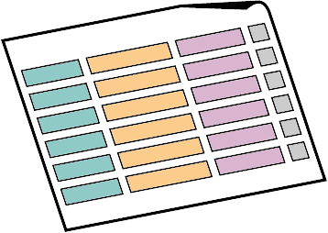


Transactions
Definition, Usage, ACID Model

Slide 5
Transactions
A Transaction is a sequence of actions (database operations) executed as a whole:
Either all of them complete successfully or none of them do
Examples:
A bank transfer from one account into another (withdrawal + deposit)
If either the withdrawal or the deposit fails the whole operation is cancelled

Slide 6

Transactions: Lifecycle (Rollback)
Read
Write
Durable starting state
Sequence of reads and writes
Durable,
consistent,
ending state
Write
Rollback

Slide 7

Transactions: Lifecycle (Commit)
Read
Write
Durable starting state
Sequence of reads and writes
Durable,
consistent,
ending state
Write
Commit

Slide 8
Transactions Behavior
Transactions guarantee the consistency and the integrity of the database
All changes in a transaction are temporary
Changes are persisted when COMMIT is executed
At any time, all changes can be canceled by ROLLBACK
All changes are persisted at once
As long as COMMIT is called

Slide 9


Transactions: What Can Go Wrong?
Some actions fail to complete
The application software or database server crashes
The user cancels the action while it’s in progress
Interference from another transaction.
What happens if several transfers run for the same account at the same time?
Notes:
Use transfer example, not cash machine for failing to complete

Slide 10


Checkpoints in games
DIE
Castle 1-1
Castle 1-2
Mario
SURVIVE

Slide 11

What are Transactions?
ROLLBACK
STATE 1
STATE 2
COMMIT
Queries
Notes:
Transaction is a sequence of actions (database operations) executed as a whole:
Either all of them complete successfully
Or none of the them
Example of transaction:
A bank transfer from one account into another (withdrawal + deposit)
If either the withdrawal or the deposit fails the whole operation is cancelled

Slide 12
Transactions Syntax
Start Transaction
Withdraw Money
BEGIN TRANSACTION
UPDATE Accounts SET Balance = Balance - @withdrawAmount
WHERE Id = @accountId
IF @@ROWCOUNT <> 1 – Didn’t affect exactly one row
BEGIN
ROLLBACK
RAISERROR('Invalid account!', 16, 1)
RETURN
END
COMMIT
Undo Changes
Save Changes
Notes:
Start a transaction
BEGIN TRANSACTION
Some RDBMS use implicit start, e.g. Oracle
Ending a transaction
COMMIT
Complete a successful transaction and persist all changes made
ROLLBACK
“Undo” changes from an aborted transaction
May be done automatically when failure occurs

Slide 13
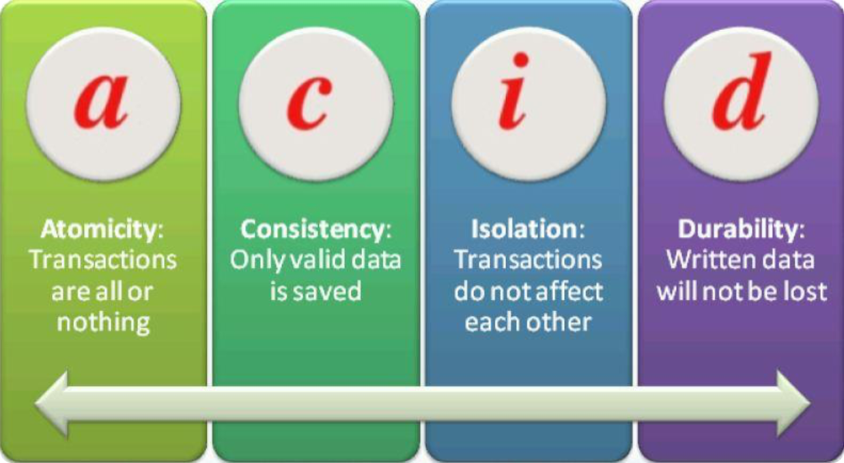
ACID Model
Solving problems before they arise

Slide 14


Transaction Properties
Modern DBMS servers have built-in transaction support
Implement “ACID” transactions.
E.g. MS SQL Server, Oracle, MySQL, …
ACID means:
Atomicity
Consistency
Isolation
Durability

Slide 15

Atomicity
Atomicity means that:
Transactions execute as a whole
DBMS guarantees that either all of the operations are performed or none of them
Example: Transferring funds between bank accounts
Either withdraw + deposit both succeed, or none of them do
In case of failure, the database stays unchanged

Slide 16

Consistency
Consistency means that:
The database has a legal state in both the transaction’s beginning and end
Only valid data will be written to the DB
Transaction cannot break the rules of the database
Primary keys, foreign keys, check constraints…
Consistency example:
Transaction cannot end with a duplicate primary key in a table

Slide 17

Isolation
Isolation means that:
Multiple transactions running at the same time do not impact each other’s execution
Transactions don’t see other transactions’ uncommitted changes
Isolation level defines how deep transactions isolate from one another
Isolation example:
If two or more people try to buy the last copy of a product, only one of them will succeed

Slide 18
Durability
Durability means that:
If a transaction is committed it becomes persistent
Cannot be lost or undone
Ensured by use of database transaction logs
Durability example:
After funds are transferred and committed the power supply at the DB server is lost
Transaction stays persistent (no data is lost)

Slide 19

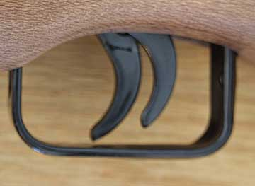
Triggers

Slide 20
What Are Triggers?
Triggers are very much like stored procedures.
Called in case of specific event
We do not call triggers explicitly
Triggers are attached to a table.
Triggers are fired when a certain SQL statement is executed against the contents of the table.
Syntax:
AFTER INSERT/UPDATE/DELETE
INSTEAD OF INSERT/UPDATE/DELETE

Slide 21
After Trigger
AFTER Trigger is executed right after an event is fired
Query
Trigger
Event

Slide 22
Instead of Trigger
INSTEAD OF Trigger completely replaces an event action from happening
You can apply totally different logic
Event
Action

Slide 23
Instead of Trigger
INSTEAD OF Trigger completely replaces an event action from happening
You can apply totally different logic
Event
Action
Trigger

Slide 24
Events
There are three different events that can be applied within a trigger:
Events
Insert
Update
Delete

Slide 25
After Triggers
Defined by the keyword FOR
CREATE TRIGGER tr_TownsUpdate ON Towns FOR UPDATE
AS
IF (EXISTS(
SELECT * FROM inserted
WHERE Name IS NULL OR LEN(Name) = 0))
BEGIN
RAISERROR('Town name cannot be empty.', 16, 1)
ROLLBACK
RETURN
END
UPDATE Towns SET Name='' WHERE TownId=1
Causes an error

Slide 26
Instead Of Triggers
Defined by using INSTEAD OF
CREATE TABLE Accounts(
Username varchar(10) NOT NULL PRIMARY KEY,
[Password] varchar(20) NOT NULL,
Active NOT NULL DEFAULT 'Y’
)
CREATE TRIGGER tr_AccountsDelete ON Accounts
INSTEAD OF DELETE
AS
UPDATE a SET Active = 'N'
FROM Accounts AS a JOIN DELETED d
ON d.Username = a.Username
WHERE a.Active = 'Y'

Slide 27
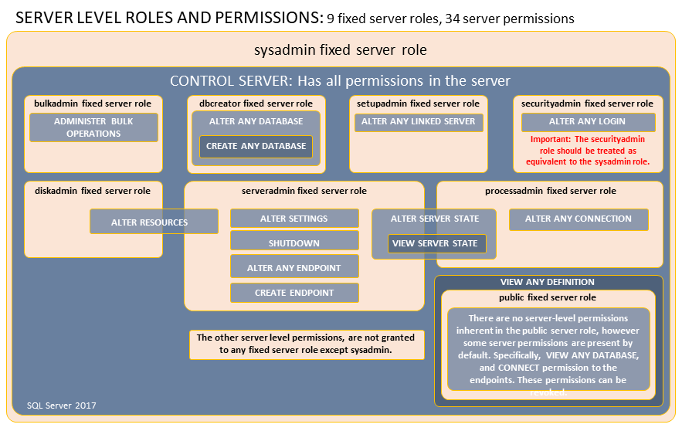

Database Security
Fixed Server Roles, Fixed Database Roles

Slide 28
Database Security: SQL Server
SQL Server has two layers of database security:
Fixed Server Roles
sysadmin, bulkadmin, dbcreator, securityadmin
Fixed Database Roles
db_owner, db_securityadmin, db_accessadmin
db_backupoperator, db_ddladmin
db_datareader/db_datawriter

Slide 29
DB Security: Fixed Server Roles (1)
sysadmin
Can do anything within SQL Server
Bypasses all security checks
dbcreator
Can create databases
Assigned automatically on database creation
securityadmin
Grants/revokes rights to databases/tables/columns

Slide 30
DB Security: Fixed Server Roles (2)
bulkadmin
Allows importing data from external files
Using BULK INSERT
Also needs INSERT rights on the table to work (db_datawriter)
BULK INSERT [TableName]
FROM 'path/to/file'
WITH
( FIELDTERMINATOR = '|',
ROWTERMINATOR = '\n')

Slide 31
Bulk INSERT: Example
Inserting values from a file
Define custom format:
Source File
Destination Table
FirstName|LastName|Salary
Ivan|Ivanov|2500
Maria|Georgieva|2600
Gosho|Ivanov|2200
Ivan|Georgiev|1500
Yordan|Georgiev|1200
Merry|Petrova|2700
Ivaylo|Hristov|1500
BULK INSERT Employees
FROM 'D:\Employees.txt'
WITH
(
FIRSTROW = 2,
FIELDTERMINATOR = '|',
ROWTERMINATOR = '\n'
)

Slide 32
DB Security: Fixed Database Roles (1)
db_owner
Can do anything in the DB
db_securityadmin
Manages role membership (grant/revoke roles)
db_accessadmin
Manages database access (allows/blocks logins)
db_backupoperator
Allows performing database backups
Does not allow restore!
Needs sysadmin, dbcreator server roles and db_owner DB role

Slide 33

DB Security: Fixed Database Roles (2)
db_ddladmin
Can CREATE/ALTER/DROP objects in DB
Cannot alter security (roles/logins/etc.)
db_datareader
Grants the user SELECT access for tables/views
db_datawriter
Grants the user INSERT/UPDATE/DELETE access

Slide 34
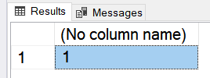
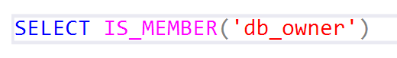
Checking Role Availability
We can check whether we’re in a role by using IS_MEMBER:
Returns one of three possible values:
1 ➔ Is a member of the role
2 ➔ Is not a member
NULL ➔ Role does not exist
SELECT IS_MEMBER('role_name')

Slide 35

Custom Roles
SQL Server lets us create custom roles
Collection of privileges (permissions)
Fine control over permissions
Can use one role for multiple users (groups)
Makes auditing operations easier

Slide 36
Custom Role Permissions
CONTROL SERVER/DATABASE
Gives all permissions on the server/database
TAKE OWNERSHIP
Enables the grantee to take ownership of a securable
VIEW CHANGE TRACKING
Manage change tracking on schemas and tables
VIEW DEFINITION
Enables the grantee to access metadata
EXECUTE
To run procedures, scalar and aggregate functions

Slide 37
Custom Role Permissions (2)
ALTER
Lets a role create, alter, and drop objects from the schema
REFERENCES
Lets the role create FOREIGN KEY constraints
SELECT/DELETE/INSERT/UPDATE
Grant access to CRUD Operations
Can be granted on database, schema and object level
Individual tables, views and columns can be targeted

Slide 38
Custom Role Permissions: Syntax
Creating a role:
Creating a login for users:
Creating user for login:
CREATE ROLE ProjectManager
CREATE LOGIN PM_Gosho
WITH PASSWORD='pass!12'
CREATE USER U_Gosho FOR LOGIN PM_Gosho

Slide 39
Custom Role Permissions: Syntax (2)
Adding members to a role:
Changing the execution context:
Checking the current execution context:
ALTER ROLE ProjectManager ADD MEMBER U_Gosho
EXECUTE AS LOGIN = 'PM_Gosho'
SELECT USER_NAME(), SUSER_NAME()

Slide 40
Custom Role Permissions: Syntax (3)
Granting permissions on role:
Revoking permissions:
Denying permissions:
GRANT INSERT, DELETE ON SoftUni.dbo.Projects
TO ProjectManager
REVOKE INSERT ON SoftUni.dbo.Projects
TO ProjectManager
DENY UPDATE ON SoftUni.dbo.Projects
TO ProjectManager

Slide 41
Summary
Transactions give our operations stability
Operation Integrity
Solving the concurrent operation problem
The ACID model is implemented in most RDBMS
Triggers apply a given behavior when a condition is hit
Gives us temporary INSERTED and DELETED tables
Security in SQL Server can be finely controlled
Using fixed server roles and fixed database roles
Custom roles control permissions even more finely
Notes:
We can create user defined functions and stored procedures in SQL Server and we can easily execute them to save code repetition.
We can create triggers that apply a given behavior when some condition has occurred.
We can make transactions if we want to be sure that if all the behavior goes as planned, all the changes are made and in the other case, no changes are applied.

Slide 42







Triggers and Transactions
https://softuni.bg/courses/databases-sqlsrv

Slide 43
License
This course (slides, examples, demos, videos, homework, etc.) is licensed under the "Creative Commons Attribution-NonCommercial-ShareAlike 4.0 International" license
Attribution: this work may contain portions from
"Databases" course by Telerik Academy under CC-BY-NC-SA license

Slide 44





Trainings @ Software University (SoftUni)
Software University – High-Quality Education, Profession and Job for Software Developers
softuni.bg
Software University Foundation
http://softuni.foundation/
Software University @ Facebook
facebook.com/SoftwareUniversity
Software University Forums
forum.softuni.bg

